Slide 1
Distributed Systems
Hierarchical algorithms:
Ho-Ramamoorthy algorithm,
Menasce-Muntz algorithm

Slide 2
Hierarchical approach – This approach is the most advantageous. It is the combination of both centralized and distributed approaches of deadlock detection in a distributed system. In this approach, some selected nodes or clusters of nodes are responsible for deadlock detection and these selected nodes are controlled by a single node.

Slide 3
Hierarchical Deadlock Detection
These algorithms represent a middle ground between fully centralized and fully distributed
Sets of nodes are required to report periodically to a control site node (as with centralized algorithms) but control sites are organized in a tree
The master control site forms the root of the tree, with leaf nodes having no control responsibility, and interior nodes serving as controllers for their branches

Slide 4
Hierarchical Deadlock Detection
Master Control Node
Level 1 Control Node
Level 2 Control Node
Level 3 Control Node

Slide 5
The Ho-Ramamoorthy Algorithm
Uses only 2 levels
Master control node
Cluster control nodes
Cluster control nodes are responsible for detecting deadlock among their members and reporting dependencies outside their cluster to the Master control node (they use the one phase version of the Ho-Ramamoorthy algorithm discussed earlier for centralized detection)
The Master control node is responsible for detecting intercluster deadlocks
Node assignment to clusters is dynamic

Slide 6
The Menasce-Muntz Algorithm
Leaf controllers allocate resources
Branch controllers are responsible for the finding deadlock among the resources that their children span in the tree
Network congestion can be managed
Node failure is less critical than in fully centralized
Detection can be done many ways:
Continuous allocation reporting
Periodic allocation reporting

Slide 7
Phantom Deadlocks
P0
R
P2
System A
System B
S
P1
T
P1 releases resource S and asks-for resource T.
2 Messages sent to Control Site:
1. Releasing
2. Waiting-for T.
Message 2 arrives at Control Site first. Control Site makes a WFG with cycle, detecting a phantom deadlock.
Notes:
Here is an illustration of how phantom deadlocks can occur in distributed systems. The diagram represents 2 systems. System A and System B. System A has process P1 holding resource S and waiting for resources T which is in system B. Resource T is presently held by Process 2.
Here process P1 sends 2 messages to the control site stating the release of resource S and need for resource T. So in case the message 2 ie waiting for T reaches the control site first then a cycle would be detected and it would be induced that the system has a deadlock. This false deadlock is called a phantom deadlock.

Slide 8
Summary
Centralized Deadlock Detection Algorithms
Large communication overhead.
Coordinator is performance bottleneck.
Possibility of single point of failure.
Distributed Deadlock Detection Algorithms
High Complexity.
Detection of phantom deadlocks possible.
Hierarchical Deadlock Detection Algorithms
Most Common.
Efficient.
Notes:
So to summarize I would like to make a brief analysis on the different architecture types of Deadlock Detection algorithms.
The centralized deadlock algorithms are not a very common and effective method as they incur large communication overhead. Also as this type depends on a Central Control Site so it represents over-reliability on a single node. Hence any degradation in performance in the central coordinator would become a performance bottleneck for the whole system. And also there is a possibility of failure of the control site thus jeopardizing the whole system.
The distributed deadlock detection algorithms are better than to centralized ones to an extent as they solve the problem of single point of control. But they are highly complex to implement. Besides they still are not able to solve the issue of phantom deadlocks.
The most common model in use today are the Hierarchical architectures. They are also the most efficient and solve the problems that are faced in other approaches.

Slide 9
Distributed Systems
Distributed Dead lock Detection:
A diffusion Computation based Algorithm,
A Global state Detection Based Algorithm

Slide 10
Distributed approach – In the distributed approach different nodes work together to detect deadlocks. No single point failure (that is the whole system is dependent on one node if that node fails the whole system crashes) as the workload is equally divided among all nodes. The speed of deadlock detection also increases.

Slide 11
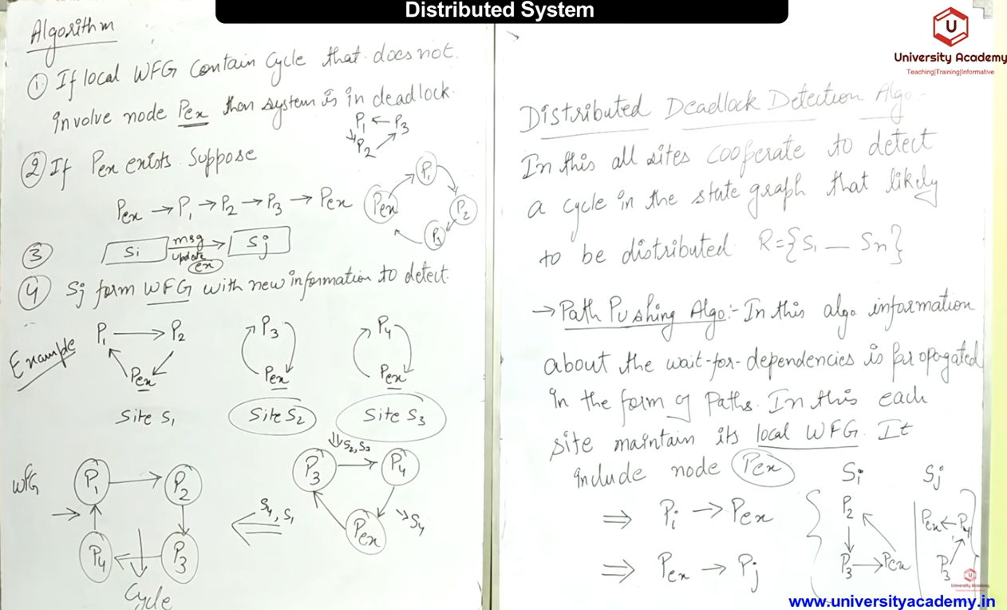
Obermarks’s

Slide 12
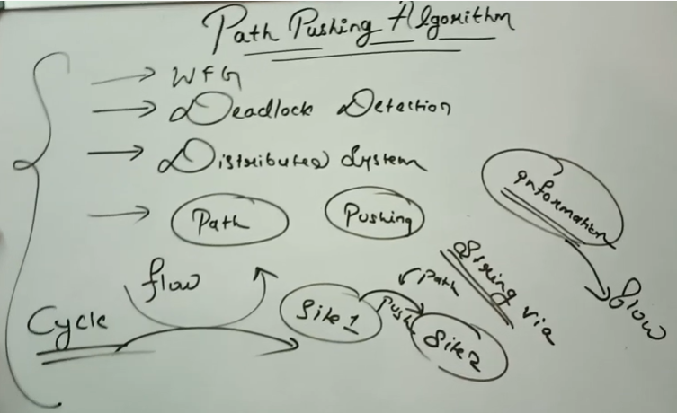
Obermarks’s

Slide 13
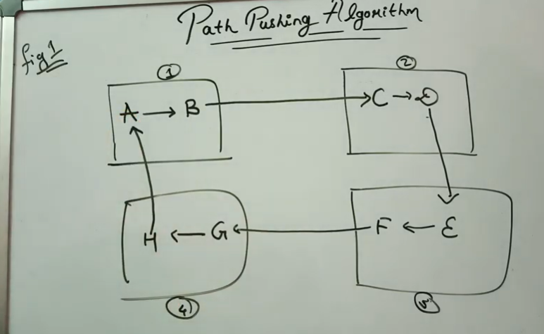
In fig 1, We can see that in site 1, A is waiting for B, in site 2 – C is waiting for D, in site 3-E is waiting for F, in site 4-G is waiting for H and there is no cycle/deadlock.
To find the deadlock, the site checks if there is any process which require the resource which is hold by process that belong to external site and thus marks it as External/ex.
Ex: A is having the resource which is required by H that is from different site. How the system can come to know? Here, we can see in the own site there is no cycle but one of its process is waiting for such a resource hold by another process that belong to other site. A path is established b/w the nodes/process from different sites.
So see in other figure:

Slide 14
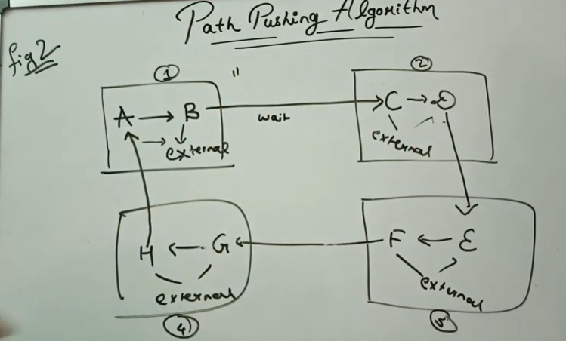
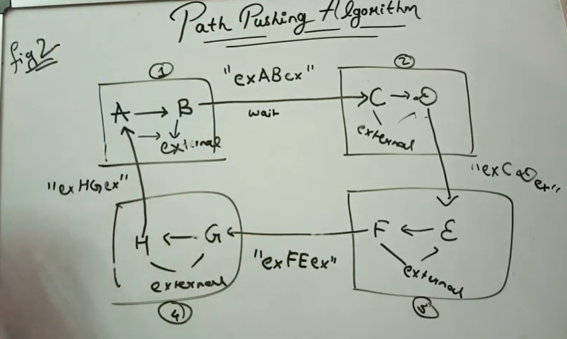
In figure 2-above, external process is identified , ie, from each site which process is dependent on the process that belong to another site .
In the fig. 2 below, a message that includes information about 2 things is pushed among sites, as:
Which process is acting as an external resource for another process(belong to different site)
The dependency of one process to other process in same site and then followed by term ex if the process has dependency on external process.
Ex: A is an external resource for process H of other site, then A is dependent on resource hold by B and B depends on resource held by C which is an external resource, so the message can be written as: exABex

Slide 15
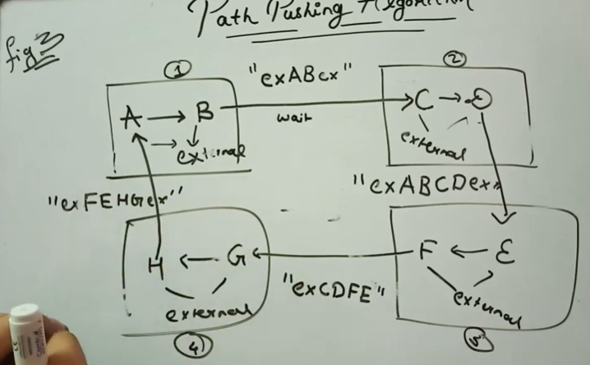
- In fig. 3, for first site ,only its message is pushed-”exABex”
- When site 2 send msg to site 3, it will combine the messages of site 1 and site 2.-”exABCDex”
- When site 3 send msg to site 4, it will combine messages of site 2 and site 3-”exCDEFex”
- When site 4 send msg to site 1, it will combine messages of site 3 and site 4-”exEFGHex”.

Slide 16
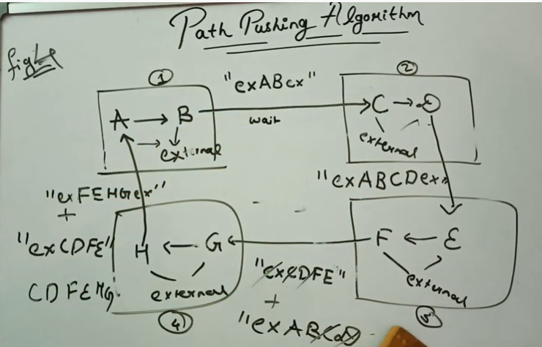
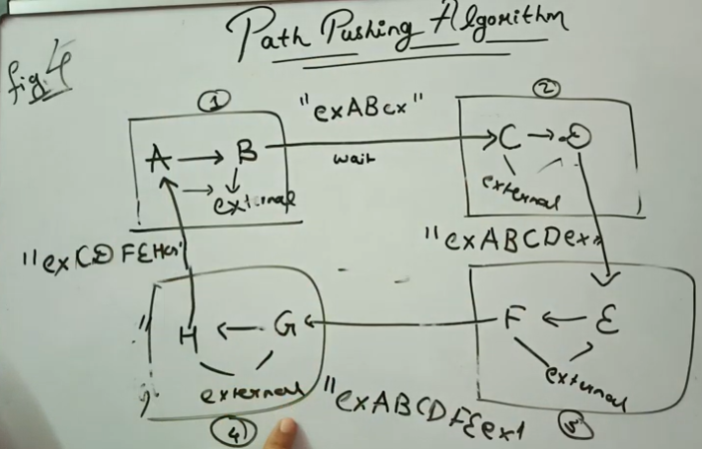
In fig. 4, the msgs from differen sites will get combined and pushed ahead, but no duplicacy of processes and ex is allowed
As the new msg is not yet floated so we will combine the previous msg only.

Slide 17
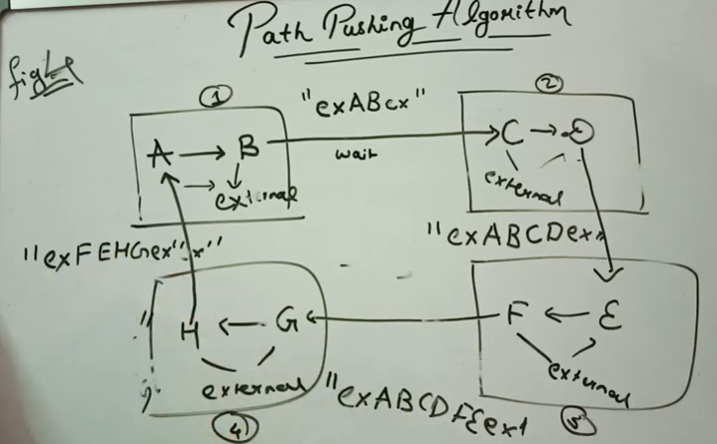

Slide 18
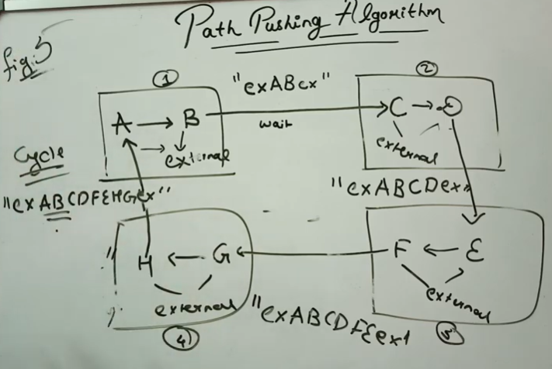
Now, it is completed. It has found the final pushed message contains the same process from where it was initiated ie. AB, so a cycle is formed and a deadlock is dedected using the message which was pushed on the path

Slide 19
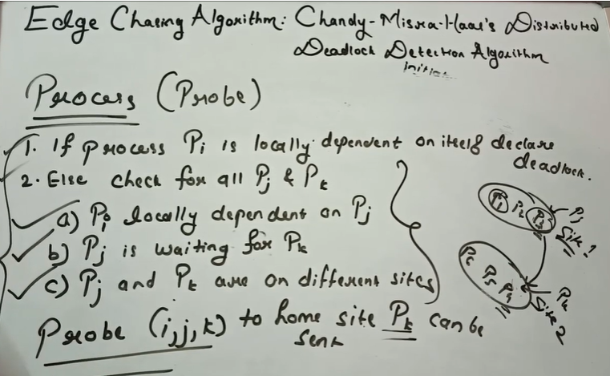

Slide 20
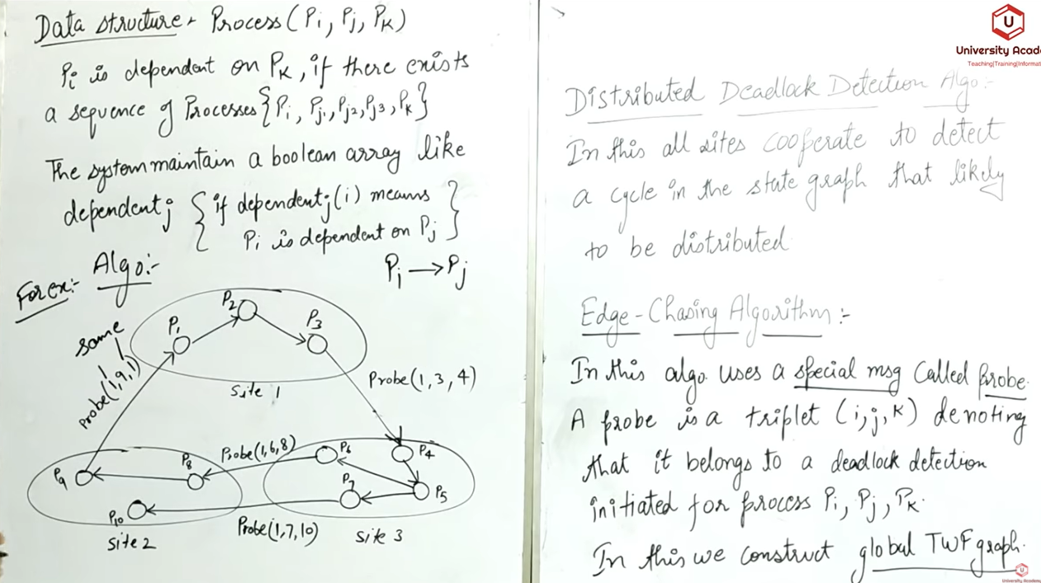
Probe(1,9,1) : As initial process and final value is same wrt message probe, so the transaction of the system is in deadlock(process is in deadlock)
Chandy-Mishra Haas’s Algorithm

Slide 21
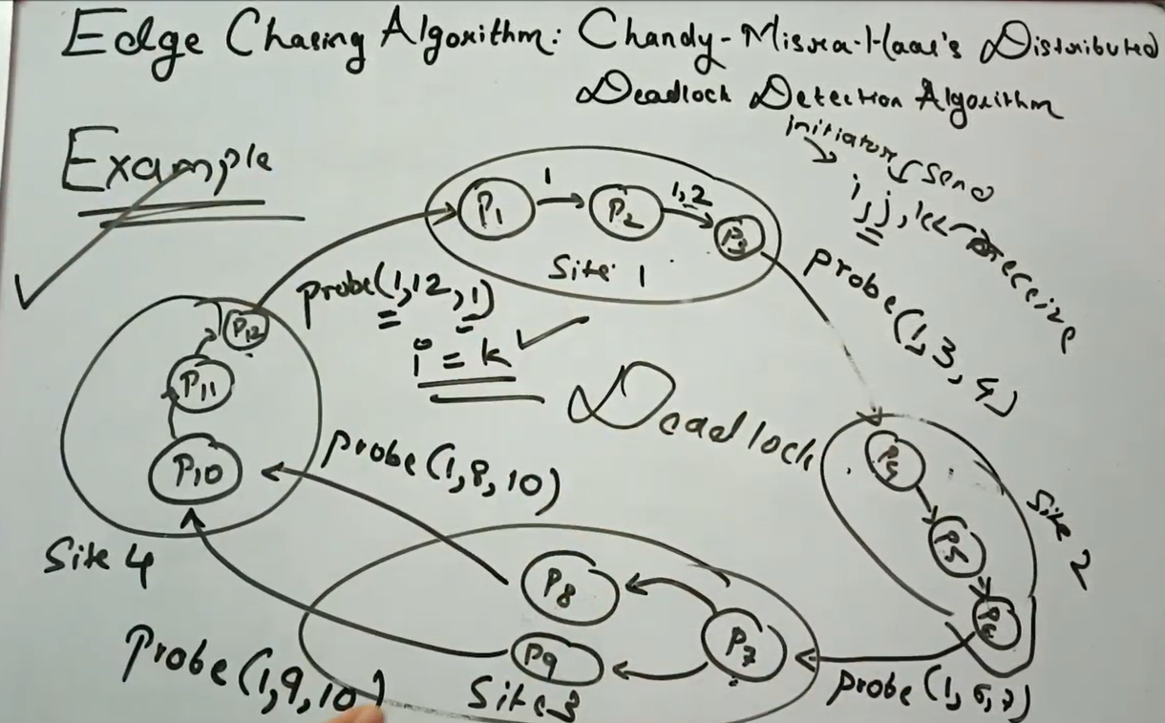

Slide 22
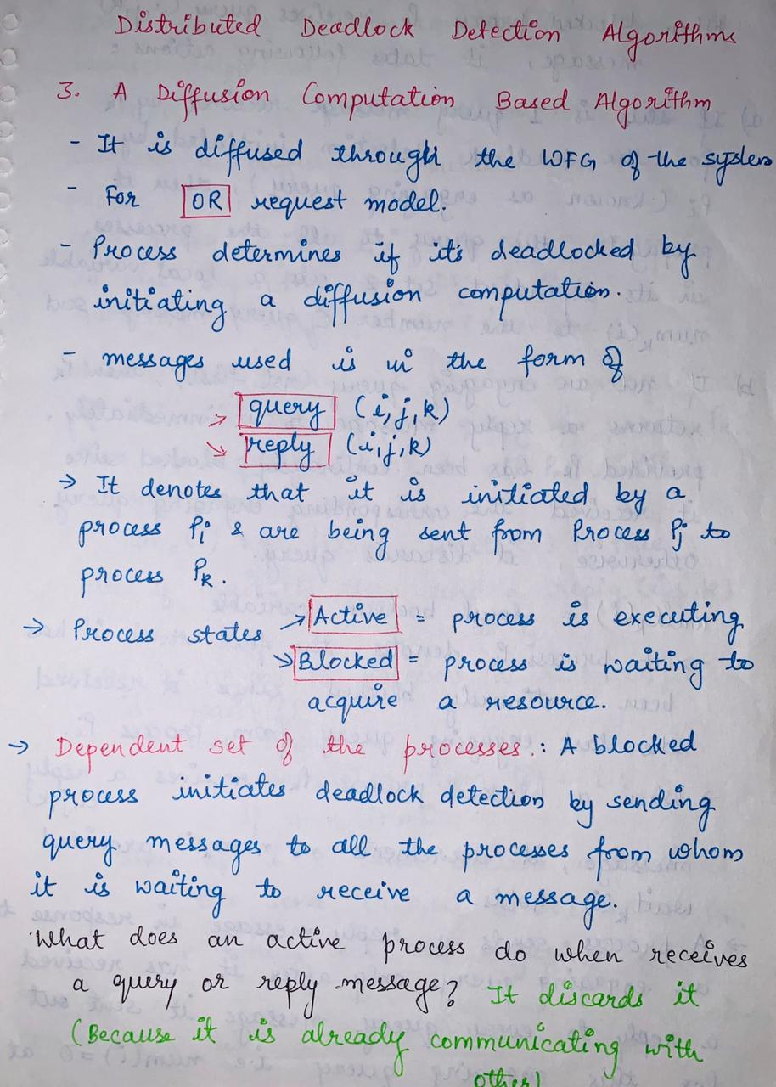

Slide 23
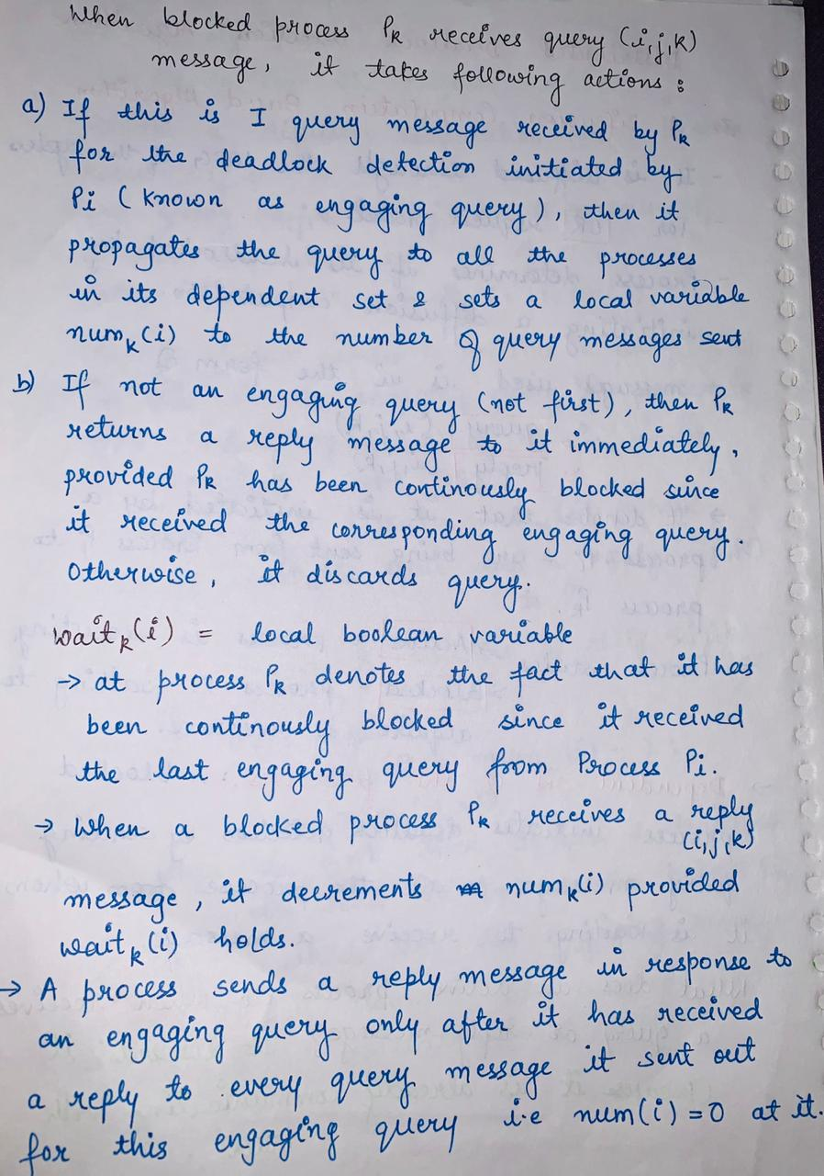

Slide 24
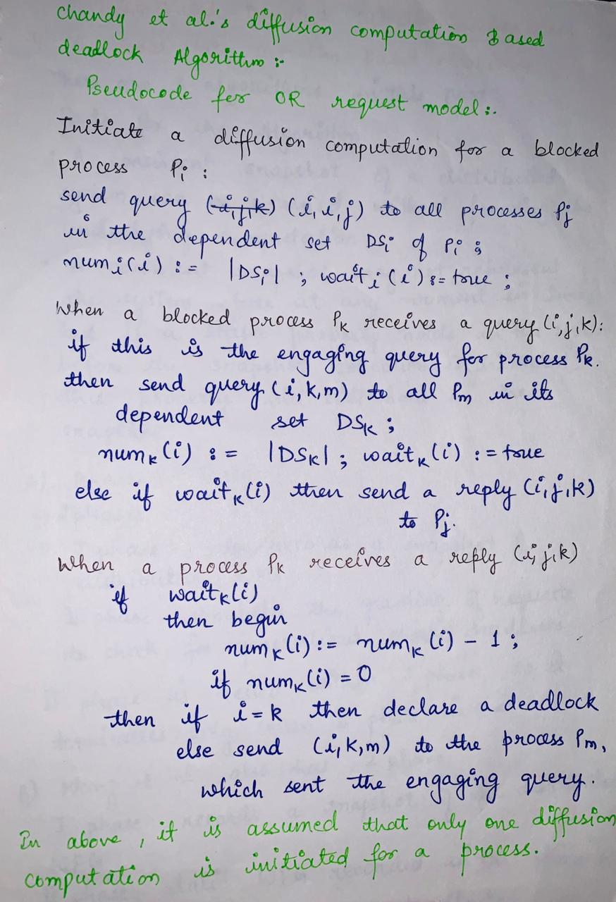

Slide 25
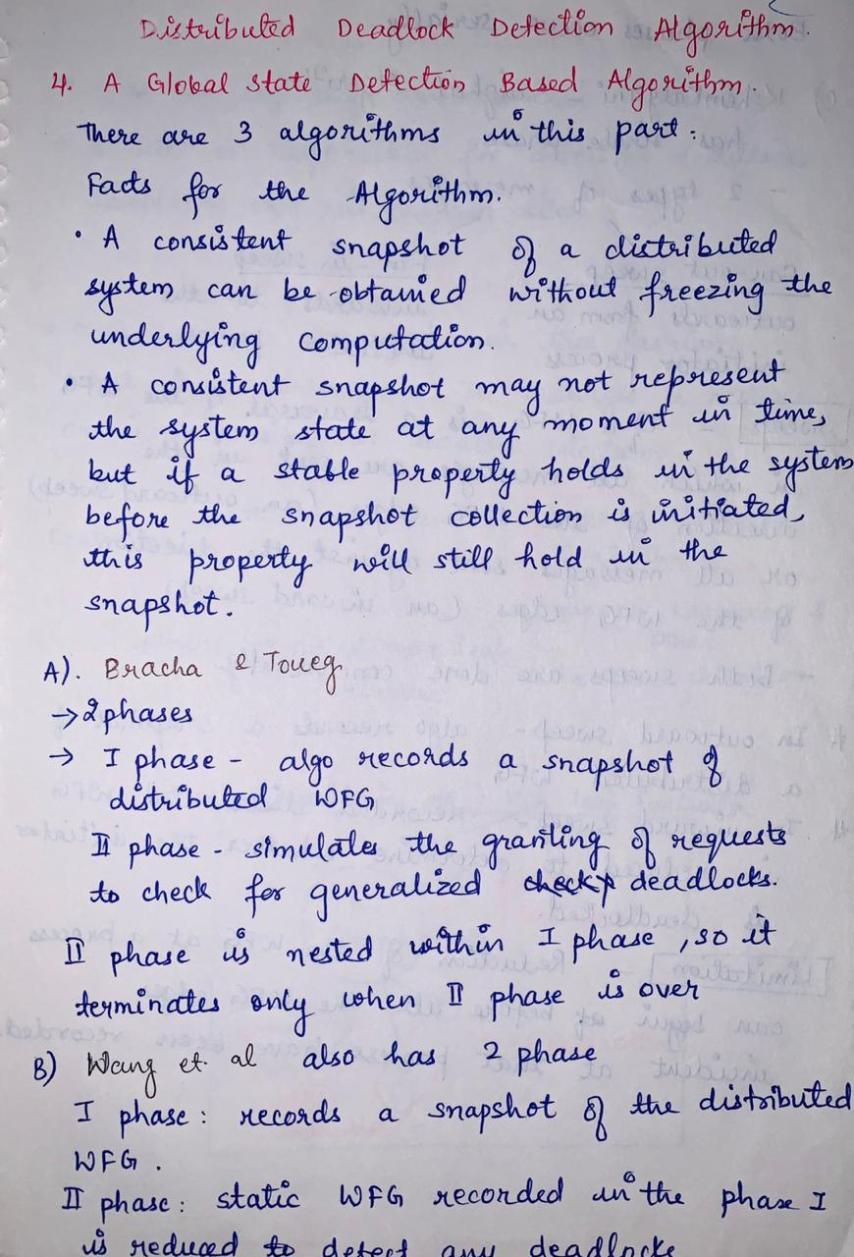

Slide 26
